Slide 1
Mentimeter
www.mentimeter.com

Slide 2
Source:
https://www.mentimeter.com/features

Slide 3
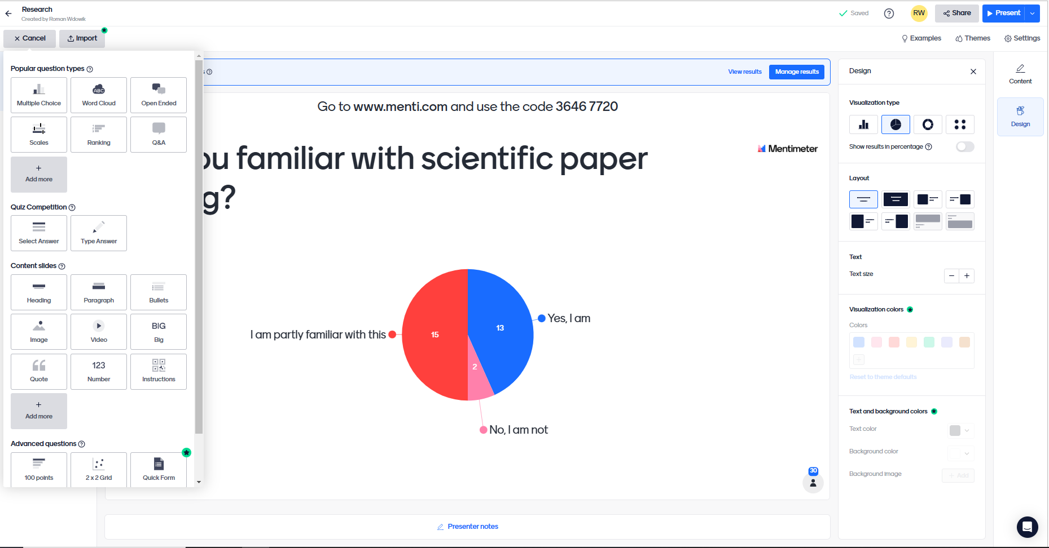
Designing a slide

Slide 4
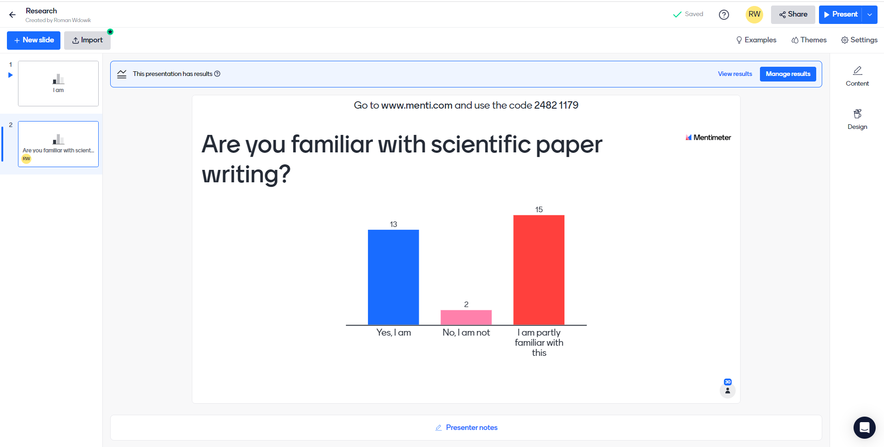
Exemplary Poll from the Edures Training in Athens
Designed by the use of Mentimeter

Slide 5
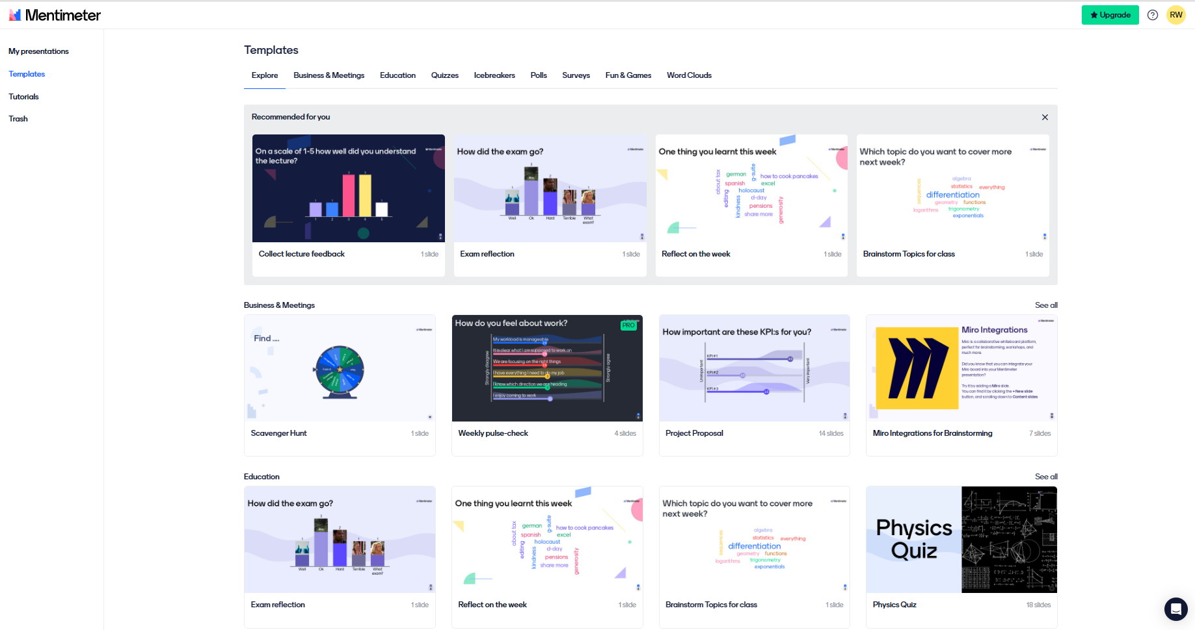
Mentimeter Templates
Source:
https://www.mentimeter.com/app/templates

Slide 6
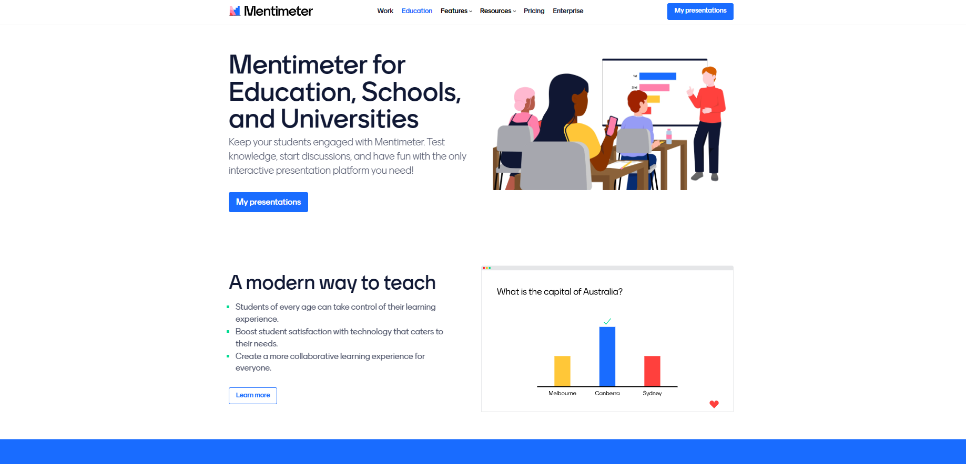
Source:
https://www.mentimeter.com/education

