Slide 1
HTTPS://QUIZLET.COM/

Slide 2
QUIZLET
https://quizlet.com/
Quizlet is a web tool and a mobile app that boosts students learning through a number of study tools that include flashcards and game-based quizzes. As a teacher, you can create your own class on Quizlet and share study sets with your students. You can either design your study sets from scratch or search for pre-made sets to customize and use in your teaching.
HOW CAN YOU USE QUIZLET DURING WORKSHOPS?
CREATE YOUR OWN STUDY SET
PREPARE AN INTERACTIVE QUIZ FOR STUDENT

Slide 3
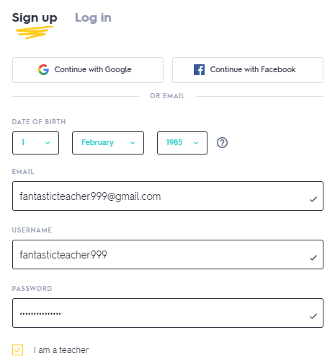
QUIZLET
REGISTRATION AND LOGIN
https://quizlet.com/
To use Quizlet you need to create a new user account on the site https://quizlet.com/ by selecting the Sign up button. You can also register using your existing Google or Facebook account.
Fill in the necessary fields for registration (date of birth, e-mail address, username and password) and indicate that you are a teacher.
If you already have a Quizlet account, select Log in.

Slide 4
QUIZLET
Create a new study set
https://quizlet.com/
To create a new Study set:
Log in to https://quizlet.com
In menu select Create → Study set

Slide 5
QUIZLET
Create a new study set
https://quizlet.com/
Fill in the form fields.
Complete the title and description of study set.
The terms and their definitions are listed on the cards.
- adding a new card
- removal of the card
You need to add min. 6 terms to use this study set to create a quiz.
* It is also possible to import files from Word, Excel, Google Docs, etc.

Slide 6
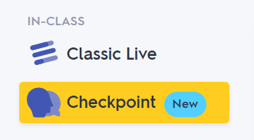
QUIZLET
Create quiz
https://quizlet.com/
In menu select Your library → Study sets → Your Study set for which you want to prepare a quiz
In the next step, select Checkpoint

Slide 7
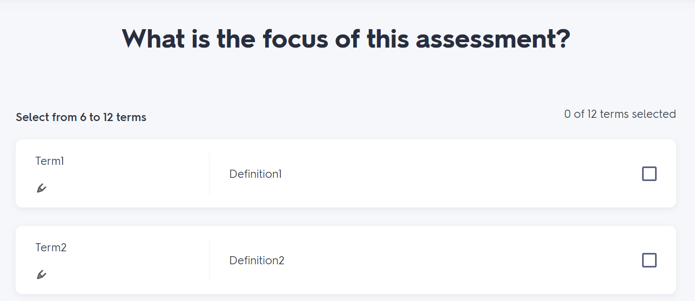
QUIZLET
CHECKPOINT
https://quizlet.com/
You have the option to start the game with terms or definitions.
To start creating a game, you need to choose from 6 to 12 individual terms.
You can also start with the quick select option at the bottom of the screen to start with random terms.

Slide 8
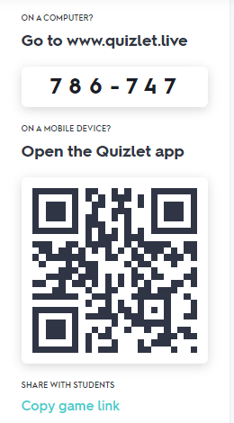
QUIZLET
CHECKPOINT
https://quizlet.com/
Students will have to scan a QR code to join the game or they can go to www.quizlet.live and enter the code at the top of the screen.
You can preview the students who have already joined the game. To start a game, at least 2 students must join.
The gameplay will start when you click the Create activity button .

Slide 9
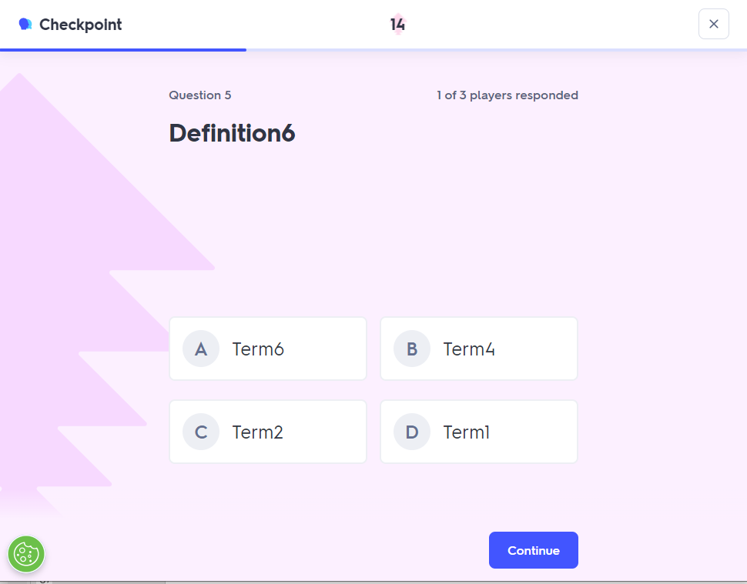
QUIZLET
CHECKPOINT
https://quizlet.com/
During the game, students answer questions.
They have 20 seconds to answer.
You can see how many students responded to the questions.

Slide 10
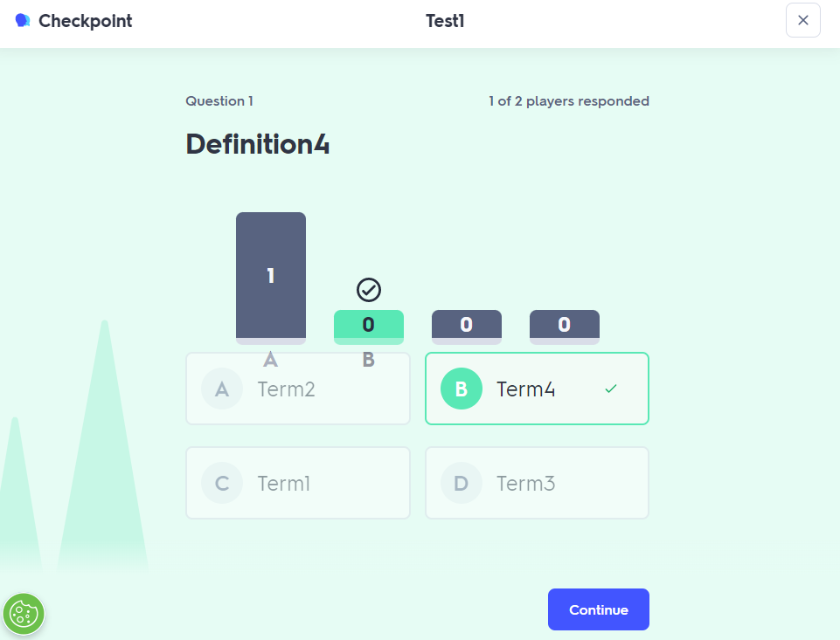
QUIZLET
CHECKPOINT
https://quizlet.com/
The round of the question ends when the time runs out or all players have answered.
Student response statistics are presented at the end of each round.
After clicking the Continue button, the round for the next question is started.

Slide 11
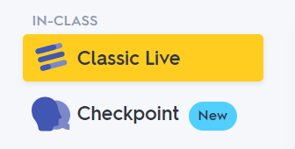
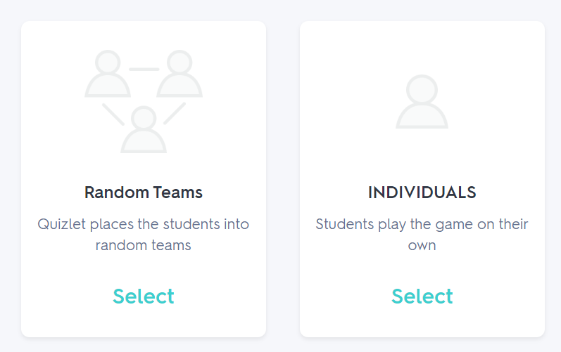
QUIZLET
Other possibilities
Classic live
https://quizlet.com/
As an alternative to Checkpoint, you can choose Classic Live game.
In Classic Live students can play as individuals or as a part of a team with up to 4 players.
To start Random Teams game, at least 4 players must join it, while a minimum of 2 players is required for the Individual game.
Before starting the game, select the combination of questions and answers you want your students to see.

Slide 12
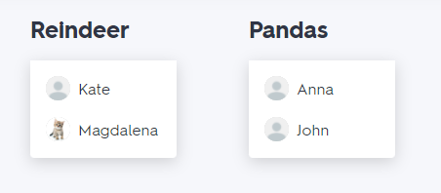
QUIZLET
Other possibilities
Classic live - Random teams
https://quizlet.com/
Students will have to scan a QR code to join the Classic Live game or they can go to www.quizlet.live and enter the code at the top of the screen.
In Random Teams game, joining students are randomly assigned to teams.
When all students have joined, click the Start Game button and a round will begin.
As the students answer the questions, you can see their progress.
The first team to correctly answer all the questions wins the game.

