Slide 1
MIRO
www.miro.com

Slide 2
What MIRO is?
Miro is a visual collaborative work environment that can be used to plan, organize, coordinate, and deliver activities. The core element of the solution is an electronic whiteboard within which embedded objects and elements from outside the environment can be added.
The whiteboard does not have a defined structure, and its organization depends primarily on the user's ingenuity. The key benefit of using Miro in teaching is the possibility of collaboration and coordination of activities via digital whiteboards, which every person involved in the process (lecturer, student, team) can view, edit and co-create. Another advantage of Miro is the support for visual thinking, creative activities and teamwork.

Slide 3
How do I use MIRO in my classroom?
MIRO gives a strong suport to:
teamwork organization
creative activities
problem solving and analytical thinking
team designing
visual thinking
interactive content presentation
workflow planning
collecting work results
gamification

Slide 4
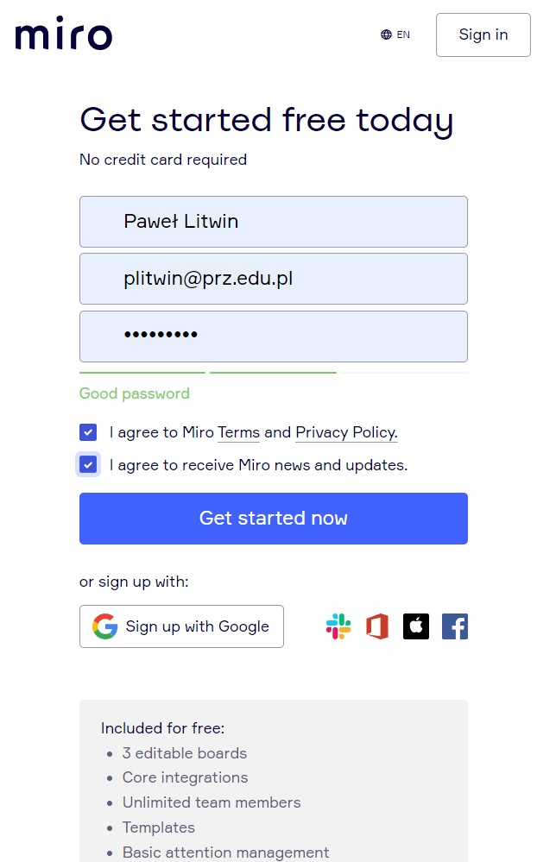
Sign up and login
Use of MIRO requires registration and log-in at www.miro.com.
Registration is intuitive, simply select Sign up free and then enter your username, email address and password.

Slide 5
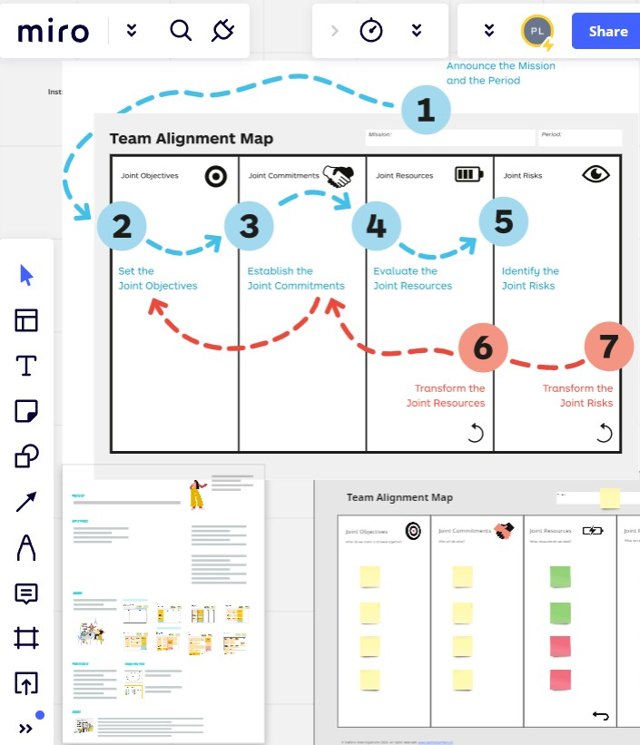
Work organization in MIRO
When working with Miro, the user creates and manages whiteboards, the content of which is entirely up to him .
The lecturer has unlimited possibilities to create didactic content on the whiteboard.
The content can be used by students individually and in teams.
Click Share to invite students to the whiteboard
Whiteboards can be organized into collections of whiteboards using the Projects section.

Slide 6
Creating a board
Click the New board option on the dashboard available after logging into Miro
To quickly organize content, you can use templates.
Additional board information can be added in the Note section, located in the upper right board corner. Select Board Annotation and enter information about the purpose of the board.

Slide 7
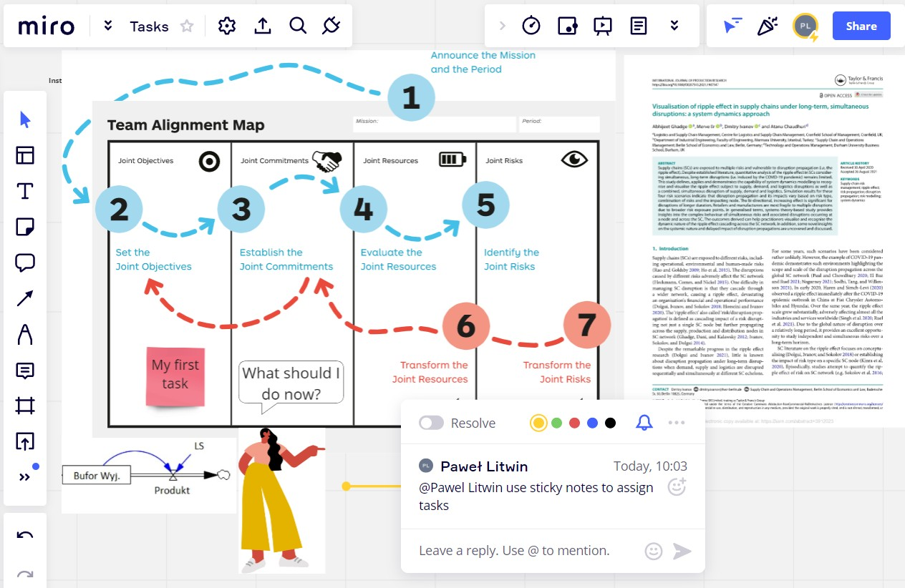
Adding elements is done by selecting an object from the tool panel, located on the left side of the whiteboard. After moving the cursor over an element, the name appears, also the icons on the panel are very intuitive. You can use built-in elements, such as: sticky notes, shapes, text fields, icons, tables, emoticons, lines pen, etc. You can also add external objects such as hyperlinks, files, audio and video clips, etc.

Slide 8
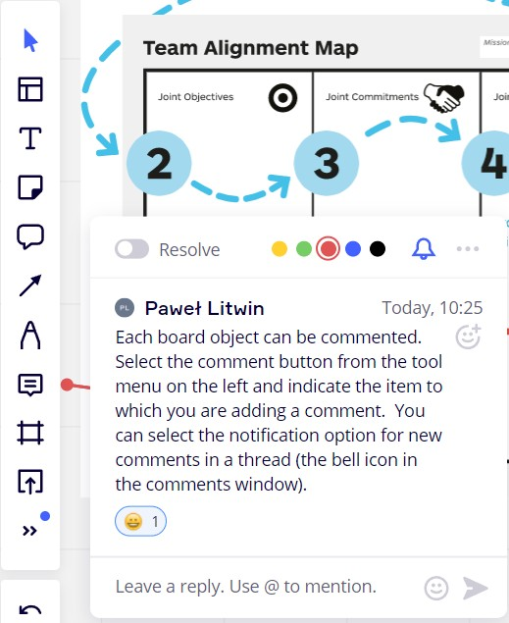
No Comments ;-)
Comments can be added by all users. There are many uses for comments in tutoring. The commonly used may include:
Team communication
Making comments on class content
Providing feedback to students.

Slide 9
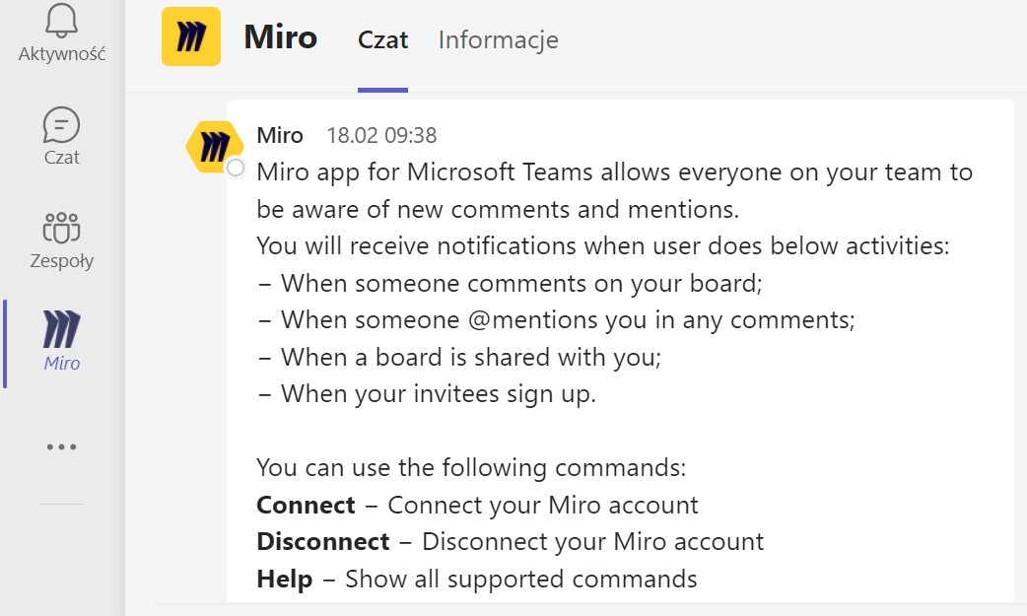
Connecting MIRO with Ms Teams

Slide 10
Useful Videos
Getting Started with Miro https://www.youtube.com/watch?v=pULLAEmhSho&t=389s
Board Basics: Making Your First Miro Board https://www.youtube.com/watch?v=7L1-0DOGHDY
Miro – Work better with online whiteboards https://www.youtube.com/watch?v=3AY0_Pfbcdw
How to Add Gamification to Your Facilitation https://www.youtube.com/watch?v=AujOrJof4Mc

