Slide 1
Trello is the visual tool that empowers your team
to manage any type of project, workflow, or task tracking.

Slide 2
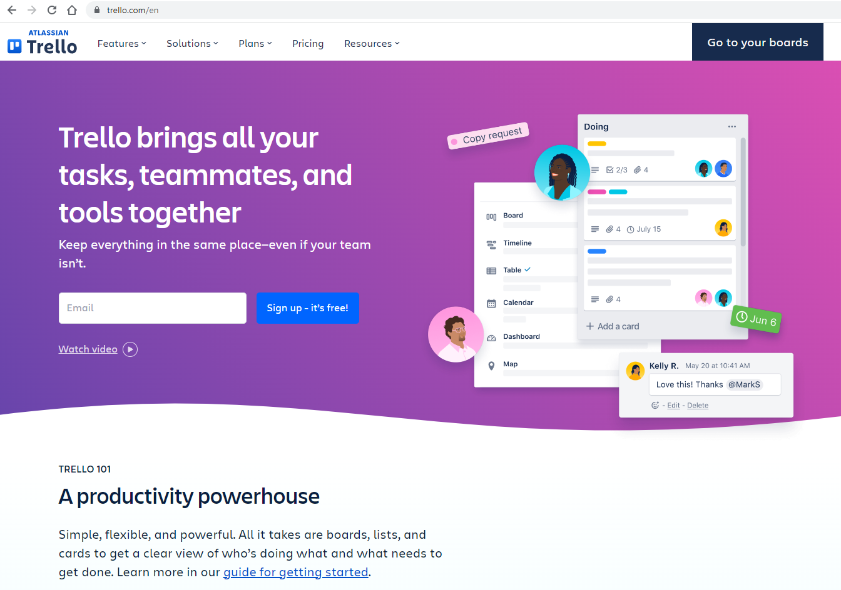
https://trello.com/en

Slide 3
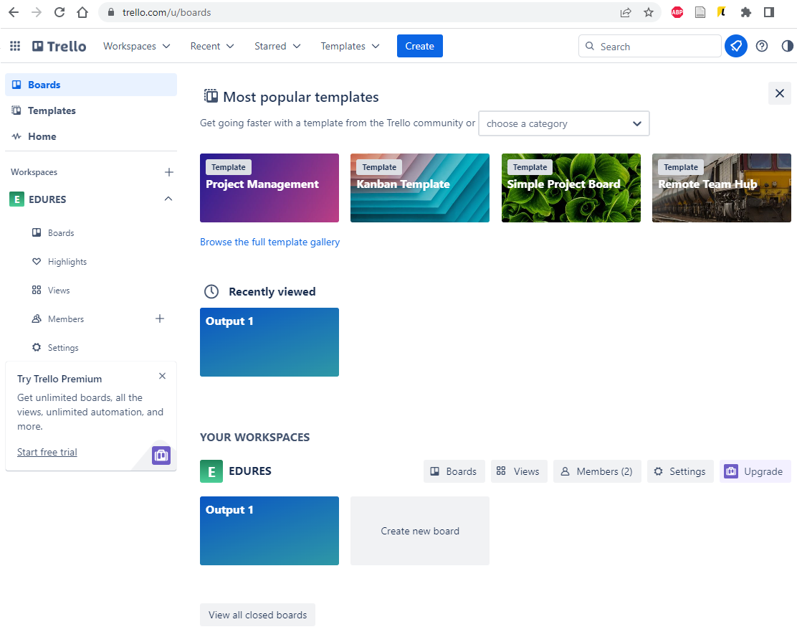
The main screen contains information about individual boards or user activity.
On the left, we have the ability to switch between boards, templates and team information.
In the center of the page are recently viewed boards.

Slide 4
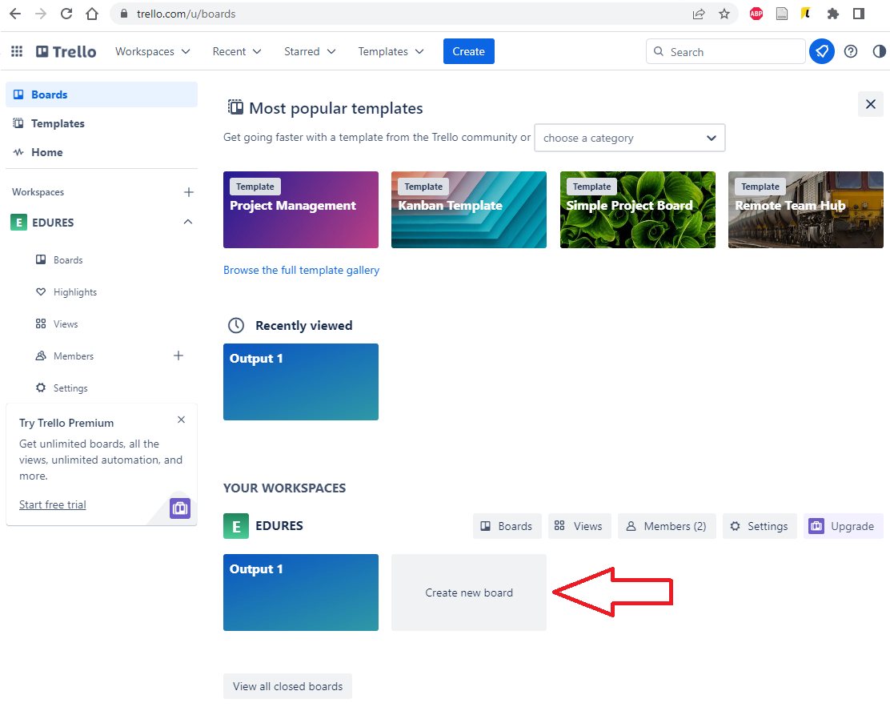
You can create a new board by clicking the Create new board button.
In the next step, the program will ask us to name the board, choose visibility - whether the board should be private,
public or visible only to our team, and will also allow us to edit the background that will be displayed.
After filling in the required information, click "Create Board".

Slide 5
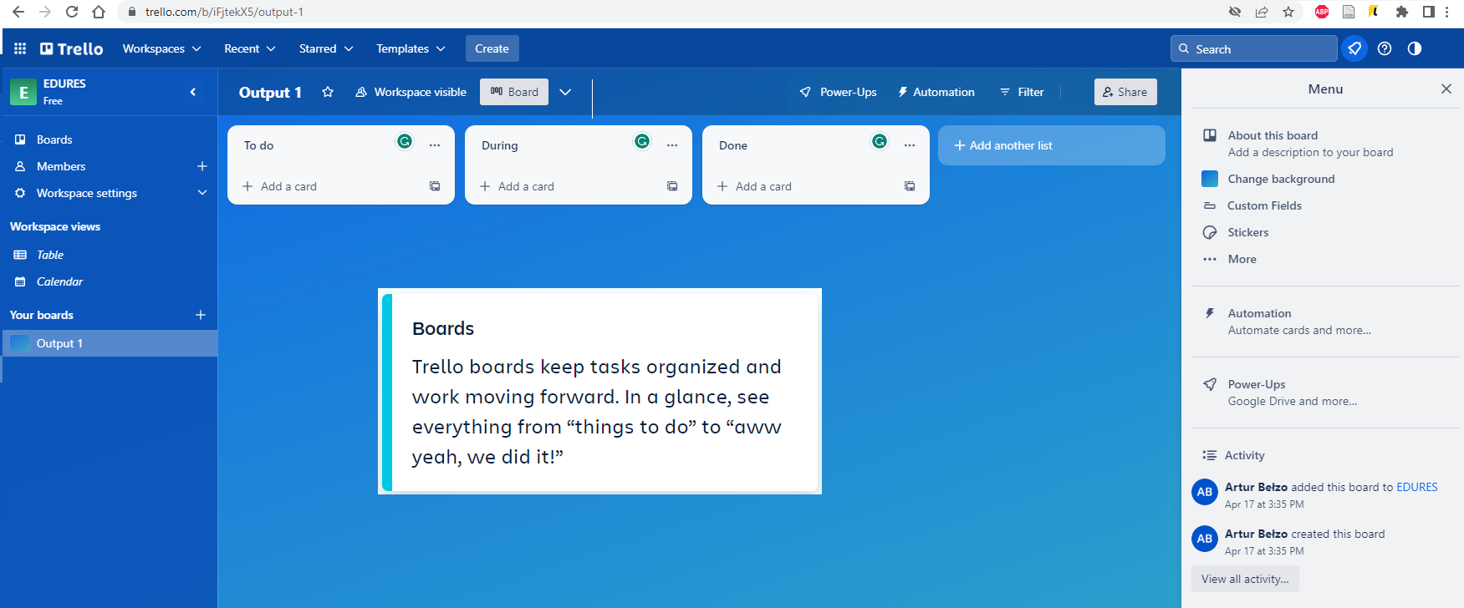
In the board, you can track information, organize and detail tasks, and collaborate with team members.

Slide 6
Lists allow you to organize cards, which are specific tasks or information, according to different stages of work progress. You can use them to create a workflow that allows you to move tabs from start to finish.
They are useful in keeping track of ideas and information.
The number of lists that can be added to an array is unlimited.
They can also be freely arranged and titled.

Slide 7
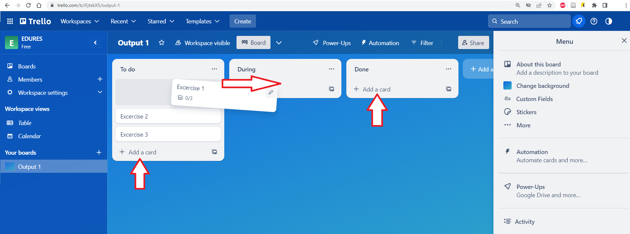
Click the "Add a card" button at the bottom of any list to create a new tab and give it a name.
Drag and drop cards into lists as tasks progress. Any number of cards can be added to the board.

Slide 8
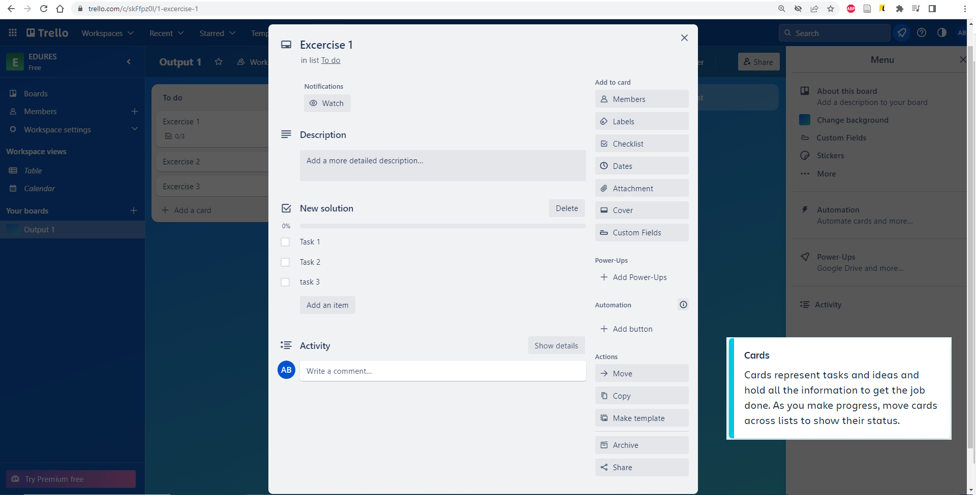
The cards are the most detailed parts of the board.
They are used to present tasks and ideas.
The card may contain information or a task to complete.

Slide 9
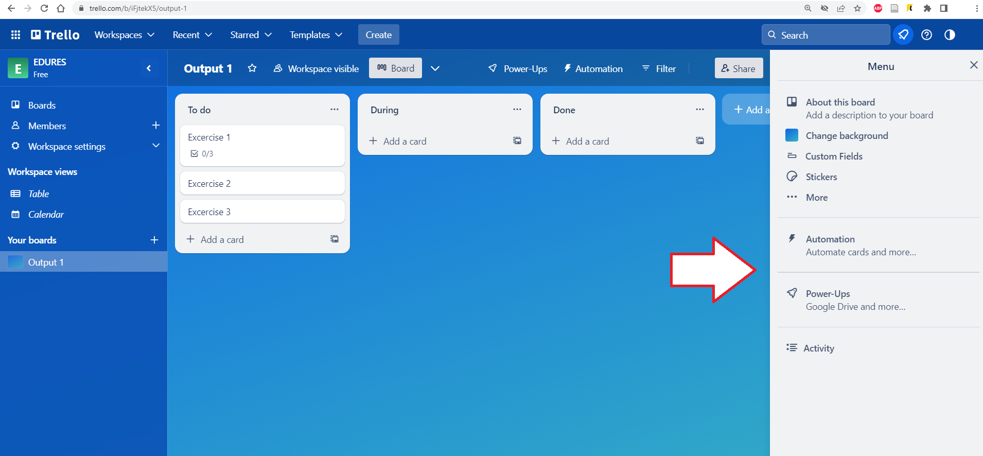
On the right is the board menu.
It is used to manage your board, member permissions, modify settings, search for tabs, enable add-ons, and create automations.

